Slide 1
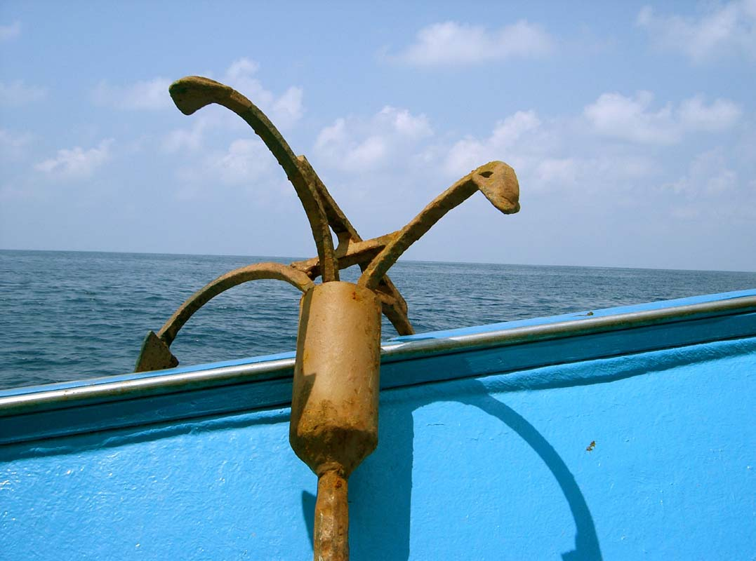
Anchor Tags
linking files to make a site
Anchor photo courtesy of https://www.flickr.com/photos/gcostanza/

Slide 2

Outcomes
Create anchor tags to link to external sites.
Write relative references for links within a web site.
Control whether link opens in new window or loads into current window.
Identify parent/child relationships among folders (aka directories) and use them to construct relative URLs

Slide 3
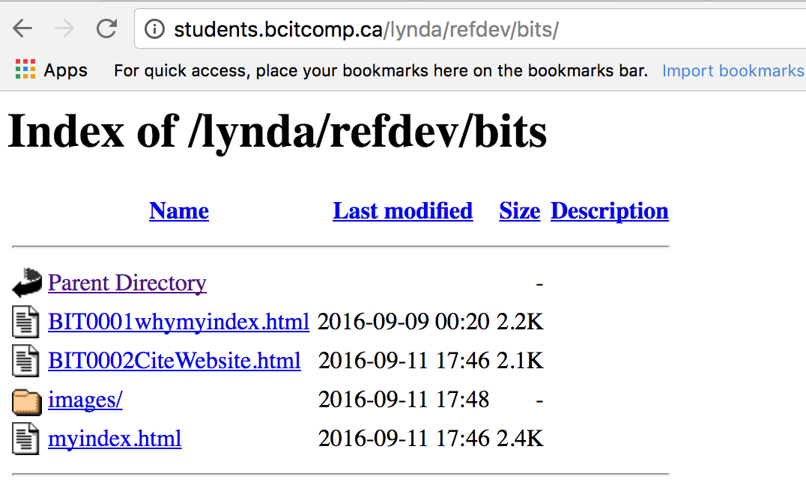
Sites are Made of Files

Slide 4
Files Exist in Directories*
/
index.html
joe.html
staff
jane.html
Aka as “folders” in most user interface displays

Slide 5
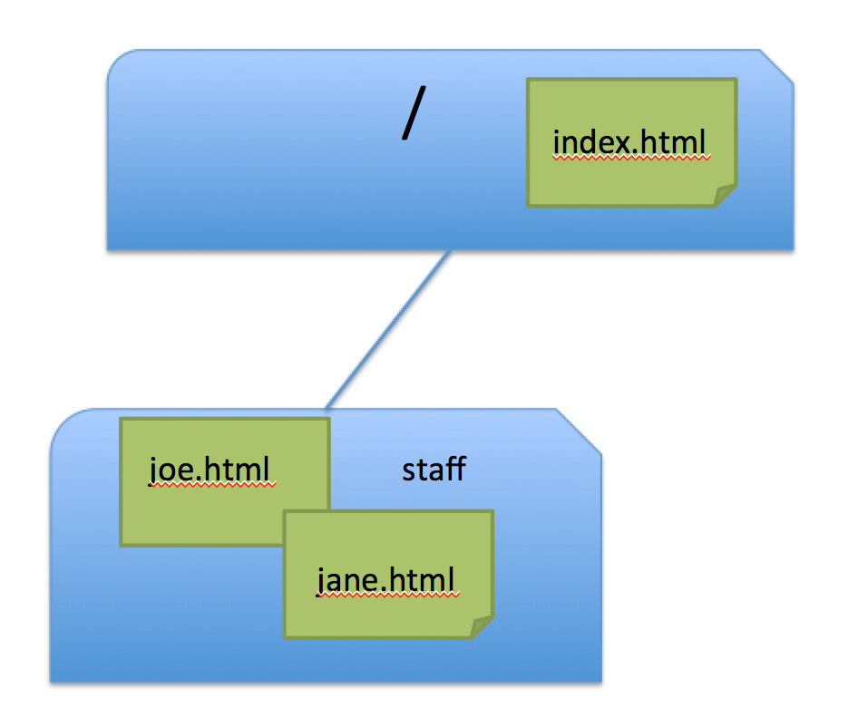
Make Links with Anchor Tag
On server my.domain.ca
<a href=“http://my.domain.ca/index.html> Home</a>
<a href=“http://my.domain.ca/staff/joe.html> Joe</a>
<a href=“http://my.domain.ca/staff/jane.html> Jane</a>

Slide 6
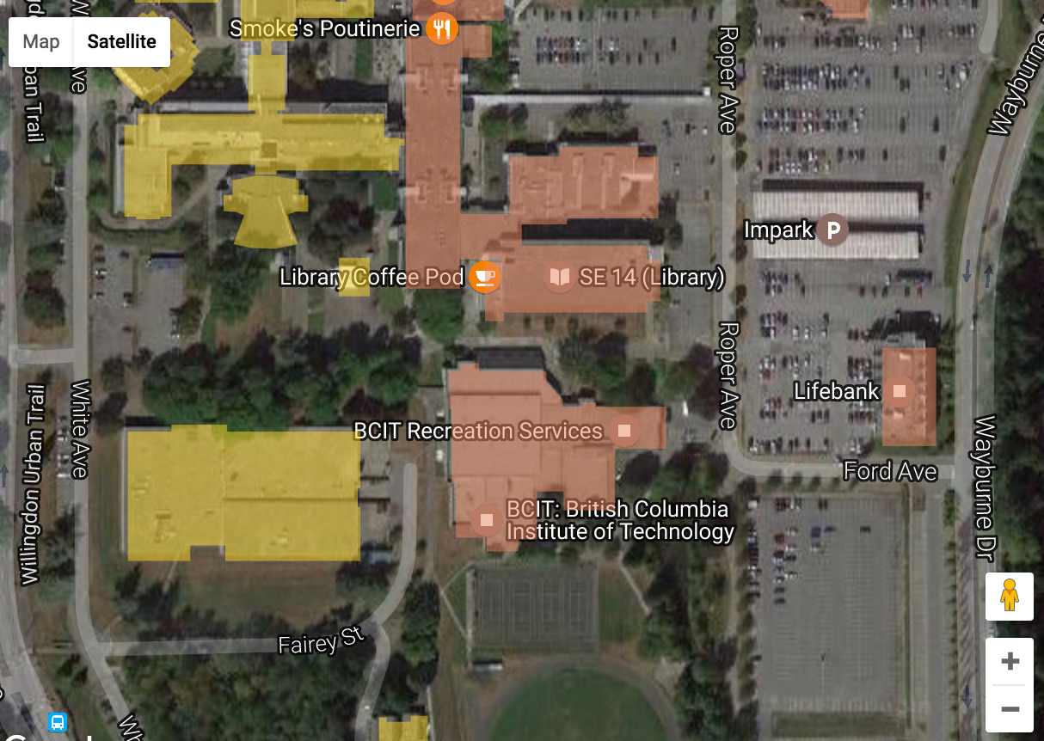
Relative Referencing

Slide 7

Directory (i.e. folder) Families
parent
child
child

Slide 8
The Current Directory
/
ROOT
written as
/
index.html
joe.html
staff
jane.html

Slide 9
The Current Directory
/
index.html
ROOT/staff
joe.html
staff
jane.html
Written as…
/staff

Slide 10
Reference files in current folder
/
index.html
joe.html
staff
jane.html
joe.html
<a href=“joe.html”>Joe</a>

Slide 11
Reference files in subfolder
/
index.html
staff/joe.html
staff/jane.html
<a href=“staff/joe.html”>Joe</a>
<a href=“staff/jane.html”>Jane</a>
joe.html
staff
jane.html

Slide 12
Reference files in parent folder
/
index.html
joe.html
staff
jane.html
../joe.html
<a href=“../index.html”>Home</a>

Slide 13
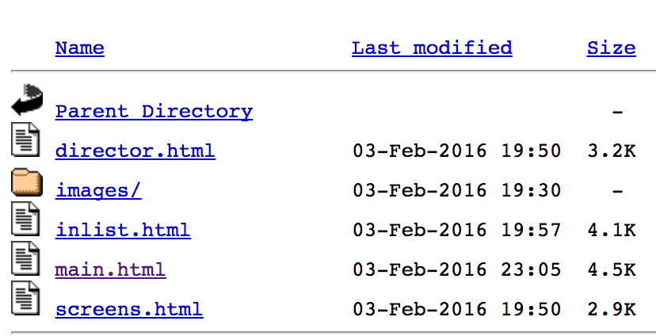
Challenge #1
Working file = main.html
Write relative reference for a link to inlist.html
<a href=“inlist.html”> the inlist file</a>

Slide 14
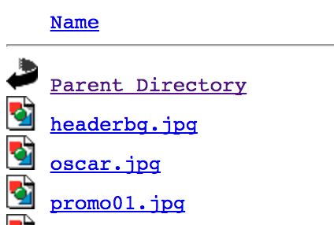
Challenge #2
Working file = screens.html
Write relative reference for a link to oscar.jpg
<a href=“images/oscar.jpg”> the oscar image</a>

Slide 15
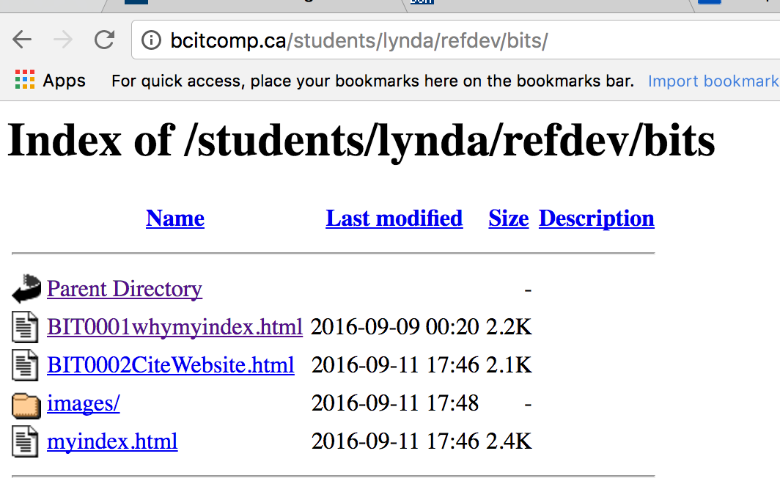
Challenge #3
Working file = myindex.html
Write relative reference for a link to myindex.html in refdev
<a href=“../myindex.html”> parent homepage</a>

Slide 16
Launching New Window
By default new pages load into the current window. To force them to load into a new window * use the target attribute.
<a href=“http://bcit.ca” target=“_blank”>BCIT Homepage</a>
Typically, new windows are opened for external sites, while internal (relative reference) links load in same window.
* Or tab, depending on user config of the browser

Slide 17
Trouble Makers
tlc-ln05:~ lyndaw$ pwd
/Users/lyndaw
tlc-ln05:~ lyndaw$ cd Desktop
tlc-ln05:Desktop lyndaw$ pwd
/Users/lyndaw/Desktop
tlc-ln05:Desktop lyndaw$ cd ..
tlc-ln05:~ lyndaw$ pwd
/Users/lyndaw
.. means “parent folder”
on unix command line
Experiment with Windows command line to get the idea

Slide 18
Trouble Makers
overloading of meaning of / in file nomenclature
http://bcitcomp.ca/students/lynda/refdev/bits/
1. //’s after http are constants required for protocol
2. / as FIRST character of PATH means “ROOT”
3. Remaining /’s are delimiters separating dirs in the PATH
4. Last / comes between end of PATH and name of file *
* If no filename given, index.html is default. Or directory listing will appear IF server is configured to allow this

Slide 19
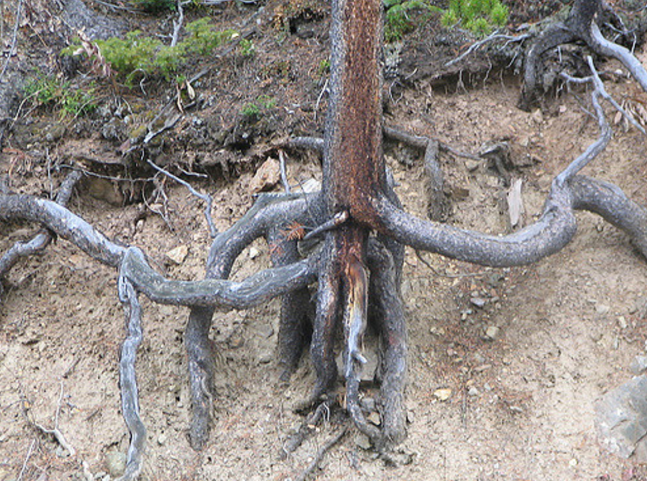

Trouble Makers
Within your own website, use relative references. NO RELATIVE REFERENCE STARTS WITH ROOT!
Root image courtesy of …

Slide 20
Challenge #1
GIVEN THE FOLLOWING FILE STRUCTURE:
/index.html
/catalog/boots.html
/services/hour.html
Working file = boots.html
Write relative reference for a link to index.html
<a href=“../index.html”> the inlist file</a>

Slide 21
Challenge #2
GIVEN THE FOLLOWING FILE STRUCTURE:
/index.html
/catalog/boots.html
/services/hour.html
Working file = index.html
Write relative reference for a link to hour.html
<a href=“services/hour.html”> the inlist file</a>

Slide 22
Challenge #3
GIVEN THE FOLLOWING FILE STRUCTURE:
/index.html
/catalog/boots.html
/services/hour.html
Working file = hour.html
Write relative reference for a link to boots.html
<a href=“../catalog/boots.html”> the inlist file</a>

